Slide 1


MT412
PowerBI Presentation
Group: 5
Group Members:
Jeff Bowers
Dami Darimola
Emma Flynn
Daniel Heather
Lauren McConnell
Cian Murray-Doyle
Notes:
Cian

Slide 2






Introducing The Data
Transactions
Countries
Products
Timeline
Customers
Contains 51,290 Transactions
Transactions In 165 Countries Across 23 Regions
17 Different Product Categories With 3,788 Unique Products
Transactions Span Across 3 Years 2012-2015
796 Unique Customers Across 3 Segments
Notes:
Cian

Slide 3



Why We Chose This Data
Timeseries & Transaction Count
Having such a large number of transactions spanning across a time frame of 3 years allows us to accurately assess any trends that are occurring over time.
Categorical Breakdowns
Data being broken down into market segment, product segment, region, state etc. allows for us to analyse the data based on categorical inputs.
Global Nature
Our data set covers every continent and over 165 countries, this allows for analysis to be specified to region, uncovering trends and insights specific to that market.
Notes:
Cian

Slide 4
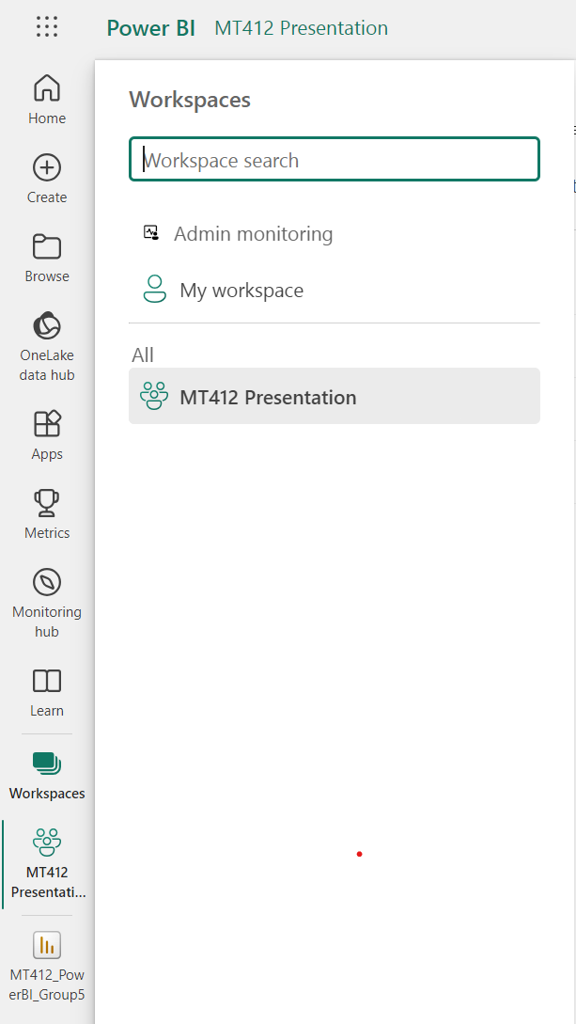
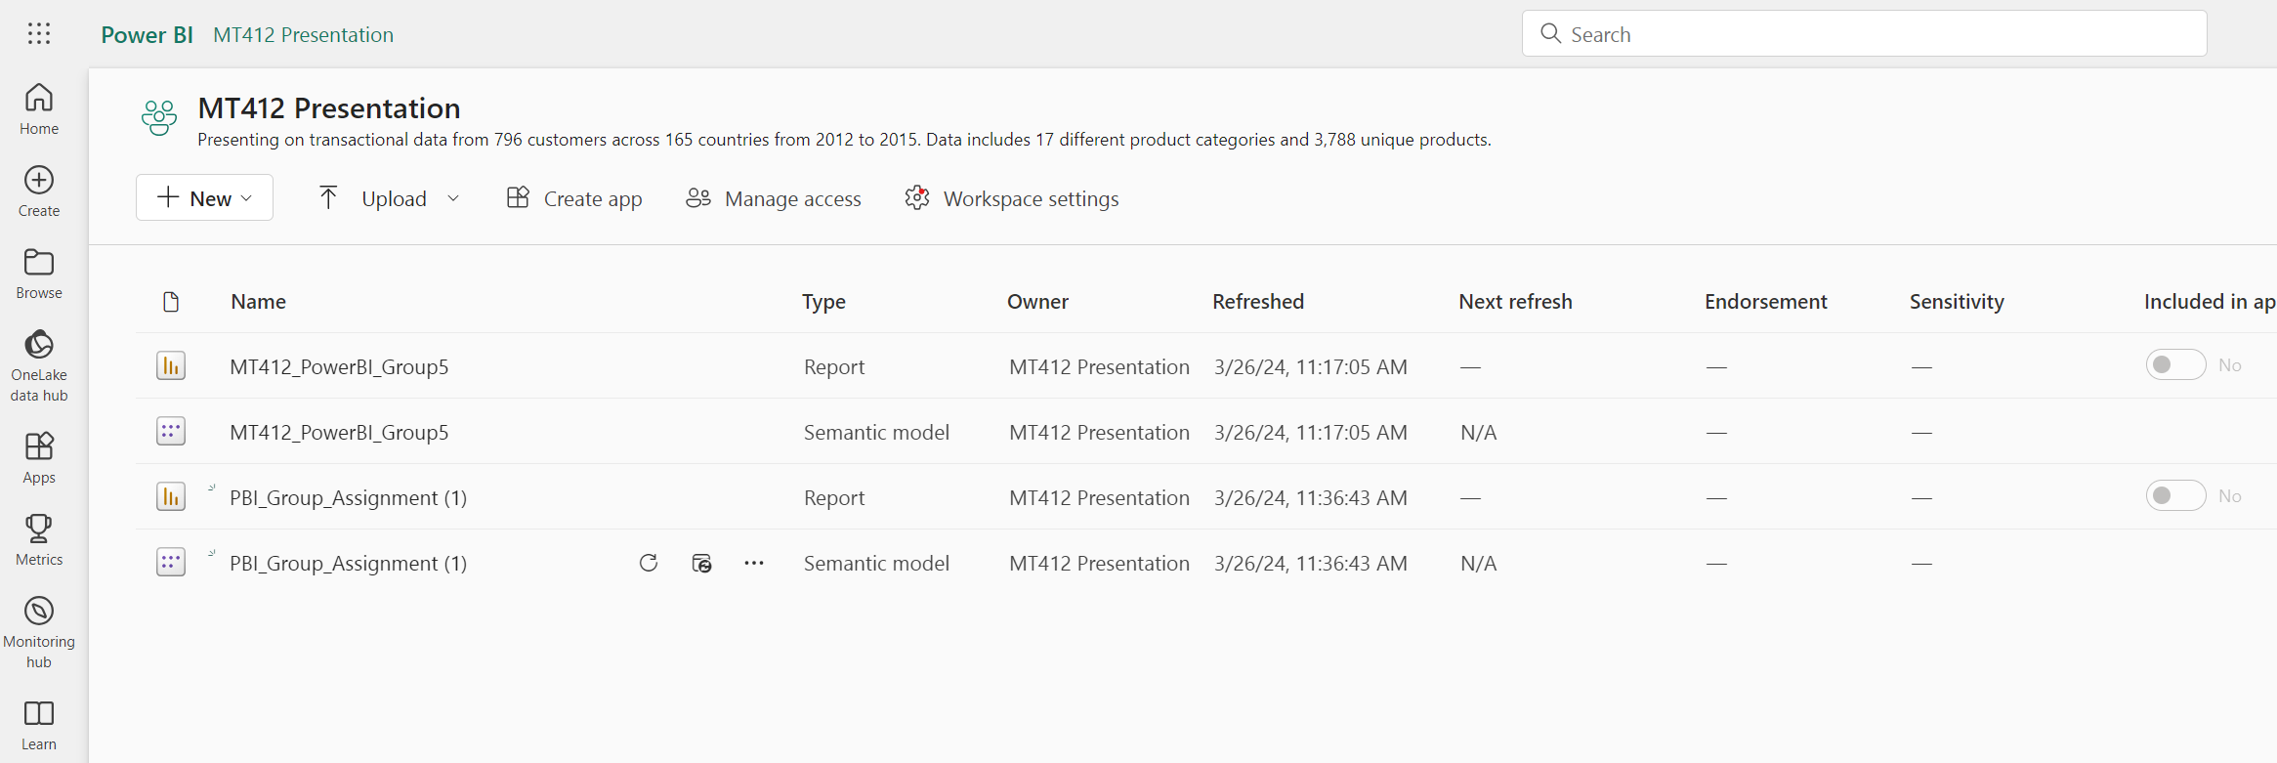
Power BI Collaboration
Notes:
Cian

Slide 5
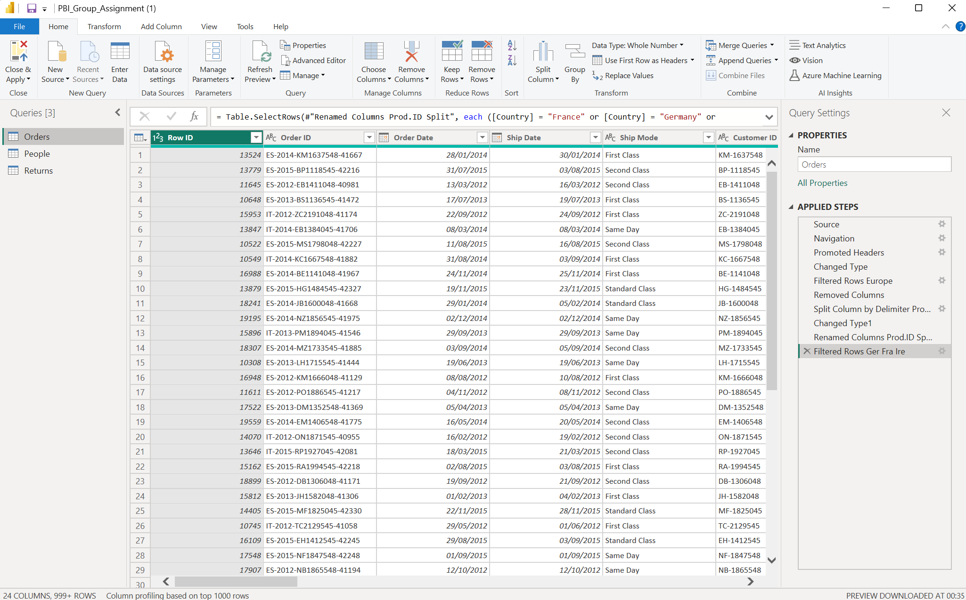
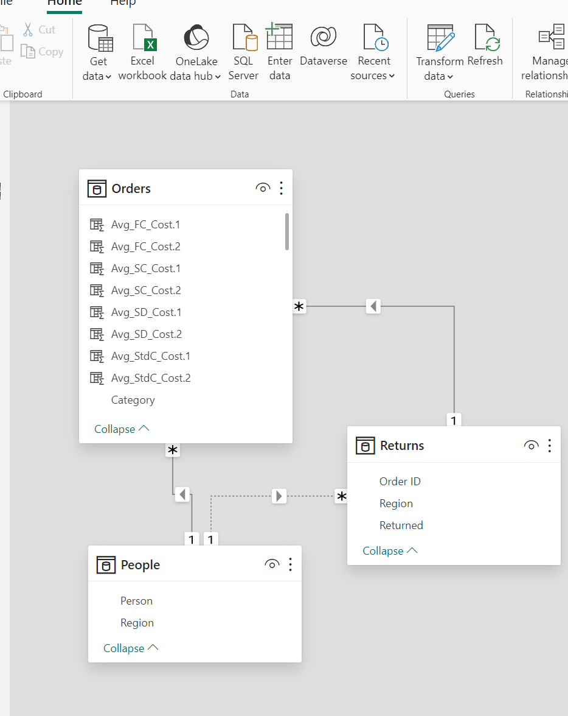
Data Transformation
Notes:
Cian

Slide 6
Data Transformation
Notes:
Cian

Slide 7




Our Key Performance Indicators
Sales Performance
Product Profitability
Customer Satisfaction
Customer Retention
Shipment Mode
Notes:
Cian

Slide 8



Big spenders make up 55.21% of customers and return the least amount.
It may be worthwhile to offer discounts to these customers and perhaps loyalty bonuses.
Conclusion
General Overview
Tools used
Recommendations

